Slide 1
Randomized Kaczmarz
Nick Freris
EPFL
(Joint work with A. Zouzias)

Slide 2
Outline
Randomized Kaczmarz algorithm for linear systems
  Consistent (noiseless)
  Inconsistent (noisy)
    Optimal de-noising
  Convergence analysis and simulations
Application in sensor networks
  Distributed consensus algorithm for synchronization
    Faster convergence and energy savings
- Faster for sparse systems
- Consensus design method

Slide 3
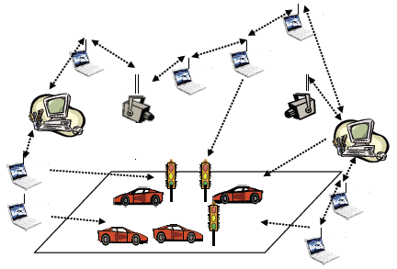
Applications
Computer science
  Parallel and distributed algorithms
  Random projections
Sensor networks
  Optimization & Control
  Distributed estimation
  Consensus
Signal processing
  Sampling
  Compressed Sensing
  Linear Inverse problems
    Imaging (ART)
    Tomography
    Acoustics
    and more..
Convergence lab (CSL, Univ. Illinois)
SmartSense, EPFL

Slide 4
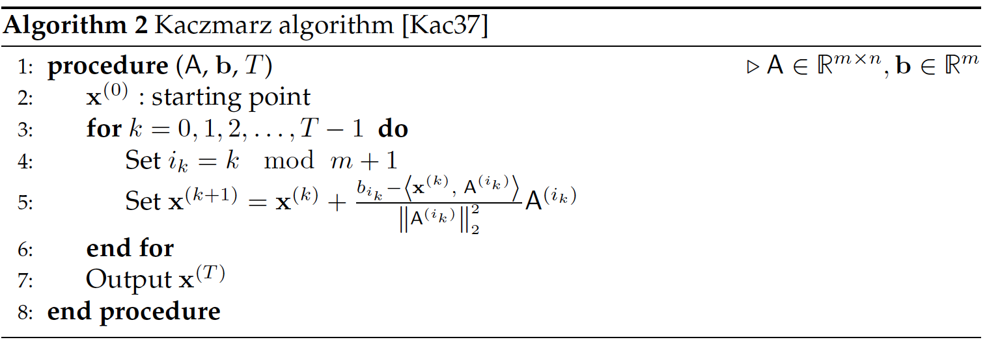
Kaczmarz algorithm
Iterative algorithm for solving
  also known as ART in image reconstruction / tomography
Convergece: alternating projections
  performance depends on row order
Round-Robin
row selection
Projection to the solution
space of selected row

Slide 5
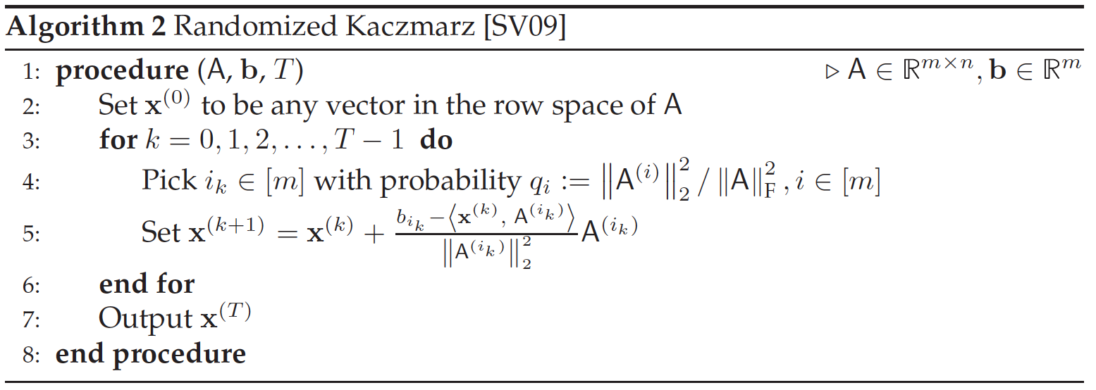
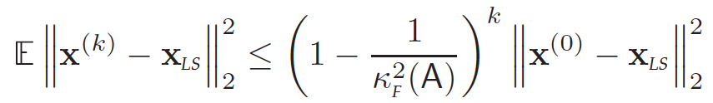

Randomized Kaczmarz
Iterative algorithm for solving
Exponential convergence in m.s. (SV’09, FZ’12)
  Rate of convergence:
Randomized selection
of row
Projection to the solution
space of selected row
  performance depends on row scaling

Slide 6

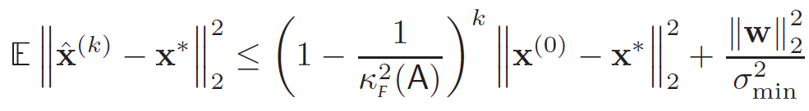


Noisy case
Noisy measurements:
Oscillatory behavior
  Asymptotically constrained in a ball (N’10, FZ’12)
Under-relaxation (RKU)
  Convergence to a point in the ball
    slower
Least-squares:
  Bad idea (squaring the condition number)

Slide 7

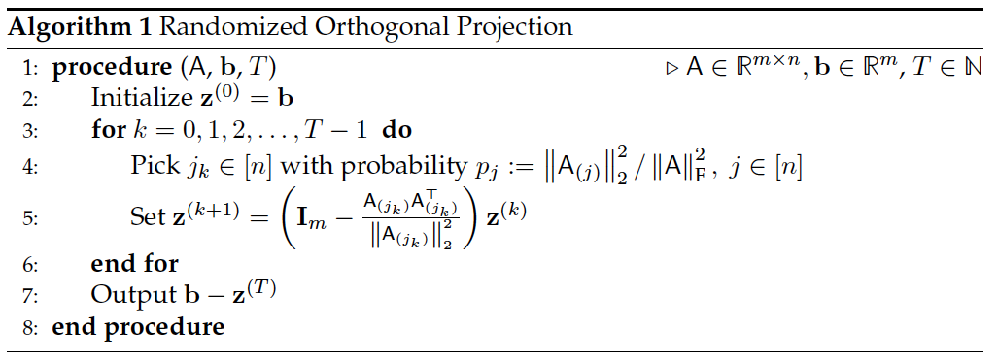
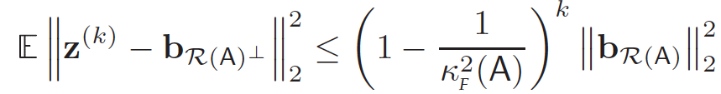
Optimal de-noising
LS for inconsistent system:
  Solution: projection to the range space of A
Randomized selection
of column
Projection to the orthogonal complement
of the selected column
  same rate of convergence

Slide 8
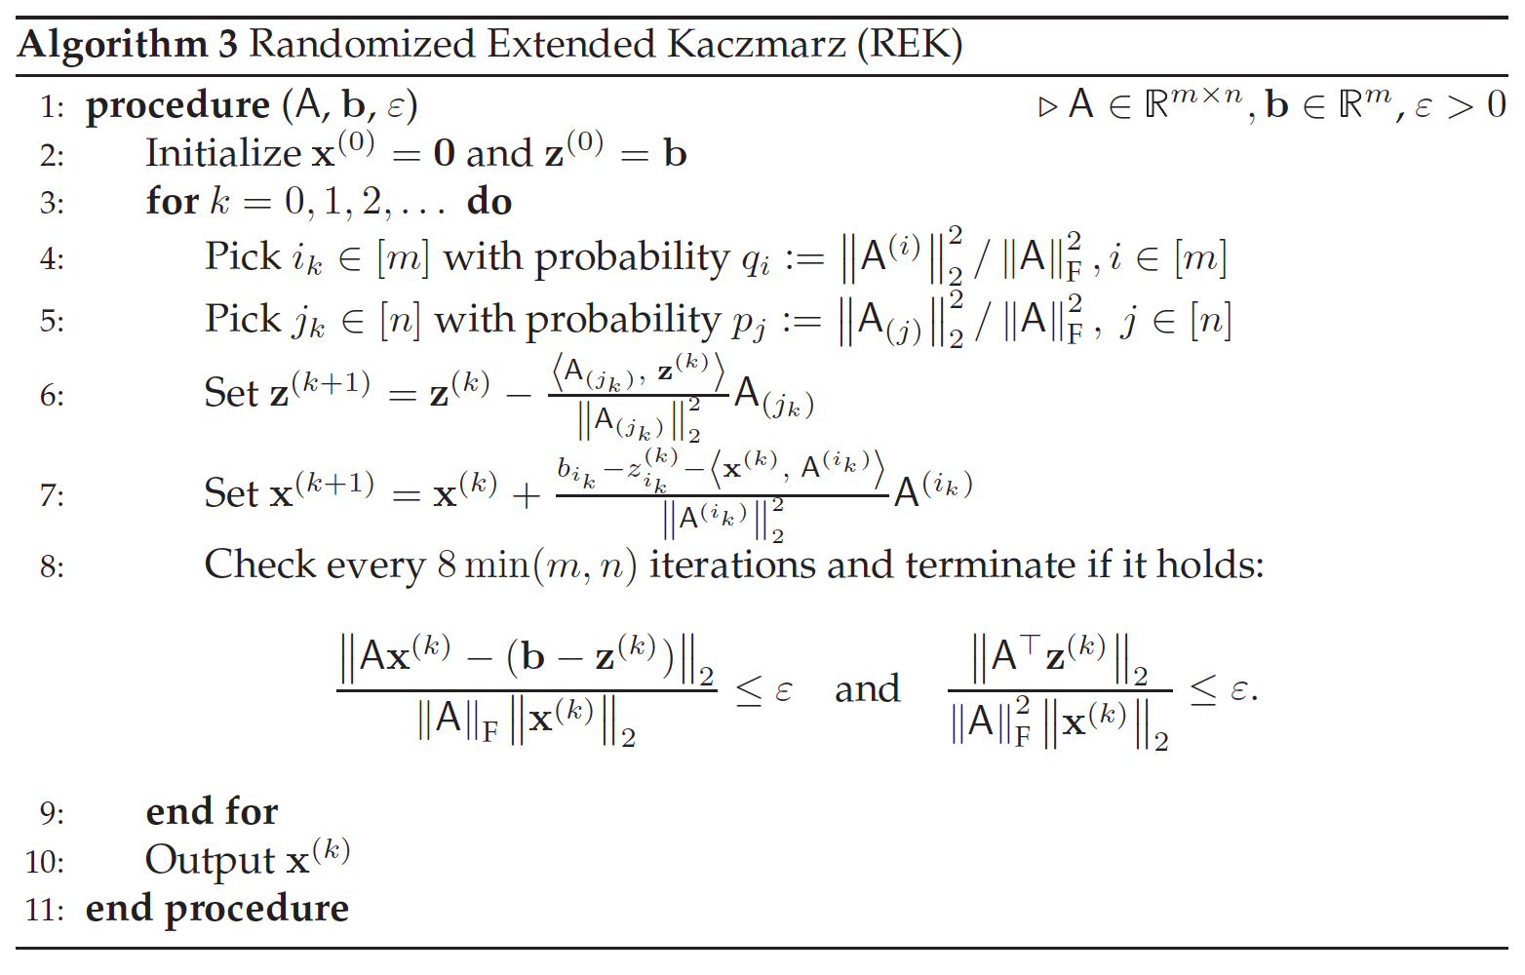
Putting the pieces together
RK and de-noising:
Randomized orthogonal projection
Randomized Kaczmarz
Termination criteria

Slide 9
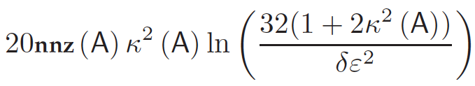
Analysis of REK
Rate of convergence (ZF’13):
    same exponent, no delay
Expected number of arithmetic operations:
  proportional to
    sparsity
    squared condition number
Designed for sparse well-conditioned systems

Slide 10
Implementation
Implementation in C
  REK-C
  REK-BLAS (level-1 BLAS routines + Blendenpik)
Comparison
  Matlab backslash \
  LAPACK
    DGELSY (QR factorization)
    DGELSD (SVD)
    LSNR
  Blendenpik

Slide 11
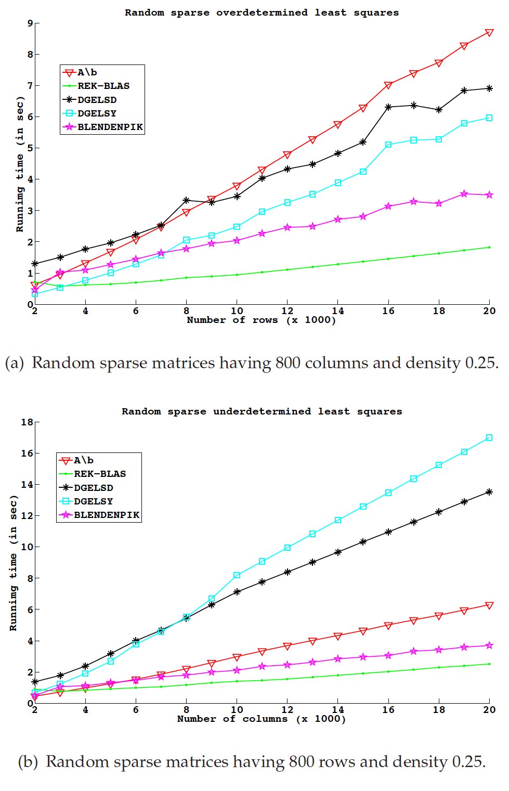
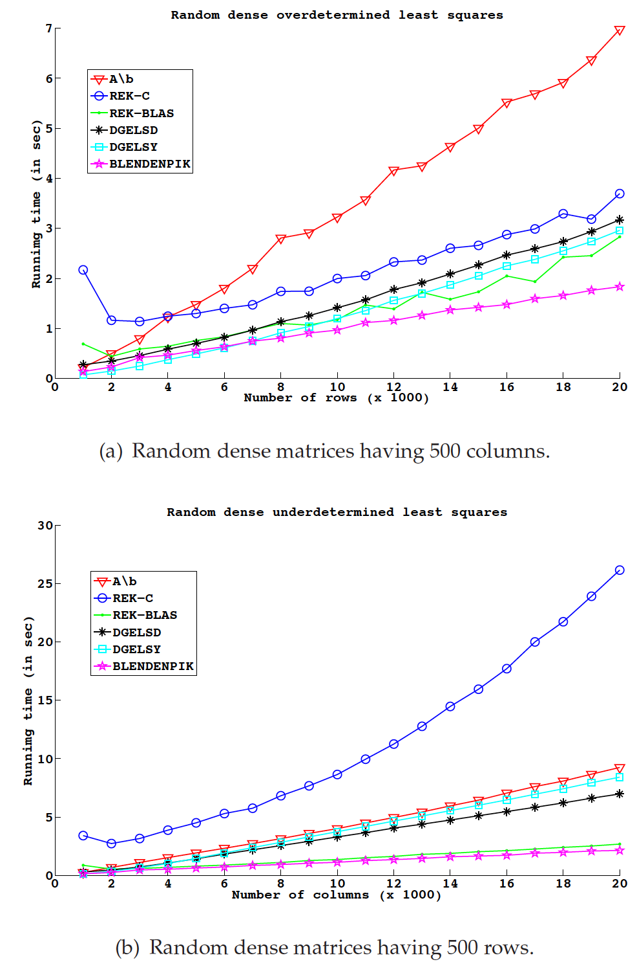
Experiments
Excellent performance for sparse systems

Slide 12
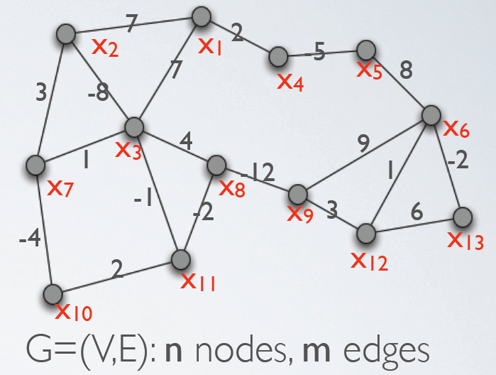
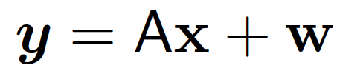
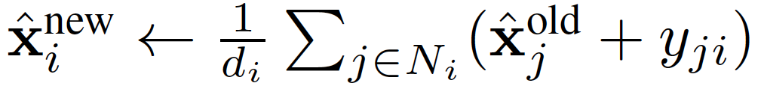
A sensor network problem
Relative measurements
  For two neighbors:
  Network problem:
Jacobi algorithm for LSE
  Local averaging (distributed)
    Synchronous: Exponential convergence (GK’06)
    Asynchronous: Exponential convergence (FZ’13)
Applications
  Clock synchronization (smoothing time differences)
  Localization (smoothing distance/angular differences)

Slide 13
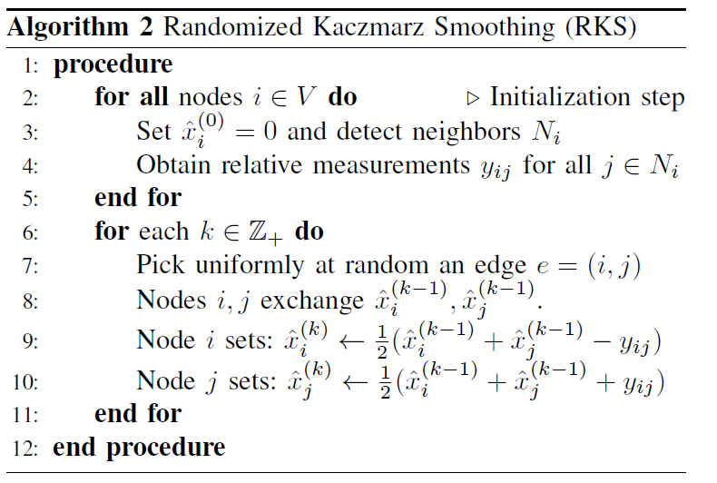
Smoothing via RK
Asynchronous implementation
  Exponential clocks
Randomized sampling
Distributed averaging

Slide 14


An extension
“Over-smoothing” (RKO)
  Faster convergence in absolute time
    vs
  More messages / iteration

Slide 15

Convergence analysis
Algorithm | Convergence | Reference
Jacobi |  | GK’06 (FZ’12)
OSE | Faster than Jacobi | BDE’06
RKS |  | FZ’12
RKLS |  | FZ’12
RKU |  | FZ’12
RKO | Faster than RKS | FZ’12
Cheeger’s inequality:
depends on network connectivity

Slide 16
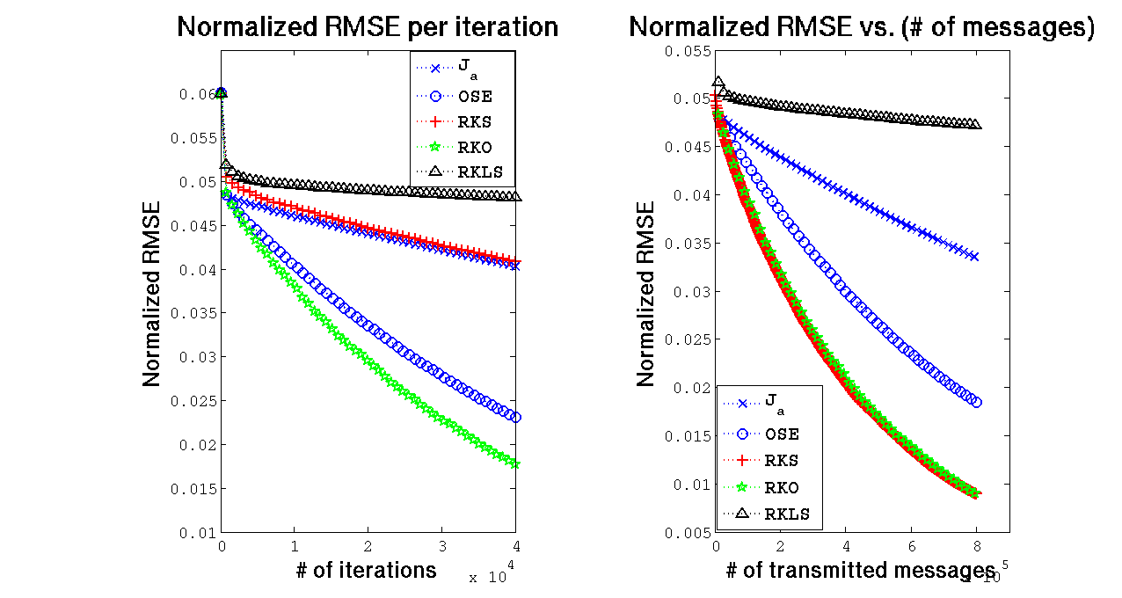
Simulations
Faster convergence
Energy savings

Slide 17
Conclusions
Randomized Kaczmarz (RK) algorithm
  Exponential convergence in the mean-square
    Same rate regardless of noise
  Distributed asynchronous smoothing
Experiments
  Linear systems: Gains for sparse systems
  Sensor networks: Faster convergence and energy savings
Efficient sparse
linear system solver

Slide 18
Ongoing work
Distributed implementation of REK
  Range projection
  matrix pre-conditioning
  termination criteria
Stochastic approximation
  convergence to the true values
    slower (gradient method)
  improved convergence
Numerical analysis is not dead!

Slide 19
References
N. Freris and A. Zouzias, “Fast distributed smoothing of relative measurements," 51st IEEE Conference on Decision and Control (CDC), pp.1411-1416, 10-13 Dec. 2012.
Anastasios Zouzias and Nikolaos Freris, “Randomized Extended Kaczmarz for Solving Least Squares.” SIAM Journal on Matrix Analysis and Applications, 34(2), 773-793, 2013.
T. Strohmer and R. Vershynin, “A Randomized Kaczmarz Algorithm with Exponential Convergence,” Journal of Fourier Analysis and Applications, vol. 15, no. 1, pp. 262–278, 2009.
D. Needell. “Randomized Kaczmarz Solver for Noisy Linear Systems.” Bit Numerical Mathematics, 50(2):395–403, 2010.

Slide 20
Thank you

